Slide 1

Best in Class Case Management Focused CE Series
PRESENTER
Catherine M. Mullahy,
BS, RN, CRRN, CCM, FCM

Slide 2
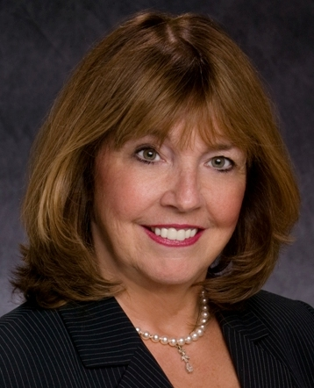
Your Presenter
Author, the Case Manager’s Handbook,
Sixth Edition
National/International Speaker
Case Management Consultant
Case Management Society of America
Lifetime Achievement Award Recipient
Recipient of the Fellow of Case
Management Designation
Catherine M. Mullahy,
BS, RN, CRRN, CCM, FCM

Slide 3

Goal
The goal of this presentation is to explore the basic responsibilities of the case manager and current case management opportunities.
It will energize your nursing or social work career, harness your intuitive vision, and offer a career of uncompromising integrity, while reclaiming your energy and passion.
3

Slide 4
Case Management Focused CE Series Overview
Gateway to Case Management Certification
Current Trends in Case Management
The Case Management Process
Integrated Medical and Behavioral Care
Cultural Issues
Award Winning Program
CCM Exam Preparation
Legal and Ethical Issues

Slide 5
Case Management Focused CE Series Overview, Cont.
Communication Skills
Healthcare Delivery Systems
Clinical Financial and Satisfaction Outcomes
The Heart of Case Management
Communication Skills
Healthcare Delivery Systems
Clinical Financial and Satisfaction Outcomes
The Heart of Case Management

Slide 6
Benefits
Learn how to prepare for the CCM exam.
1
Prepare for leadership in case management in your department or business.
2
Expand your career opportunities and income.
3

Slide 7
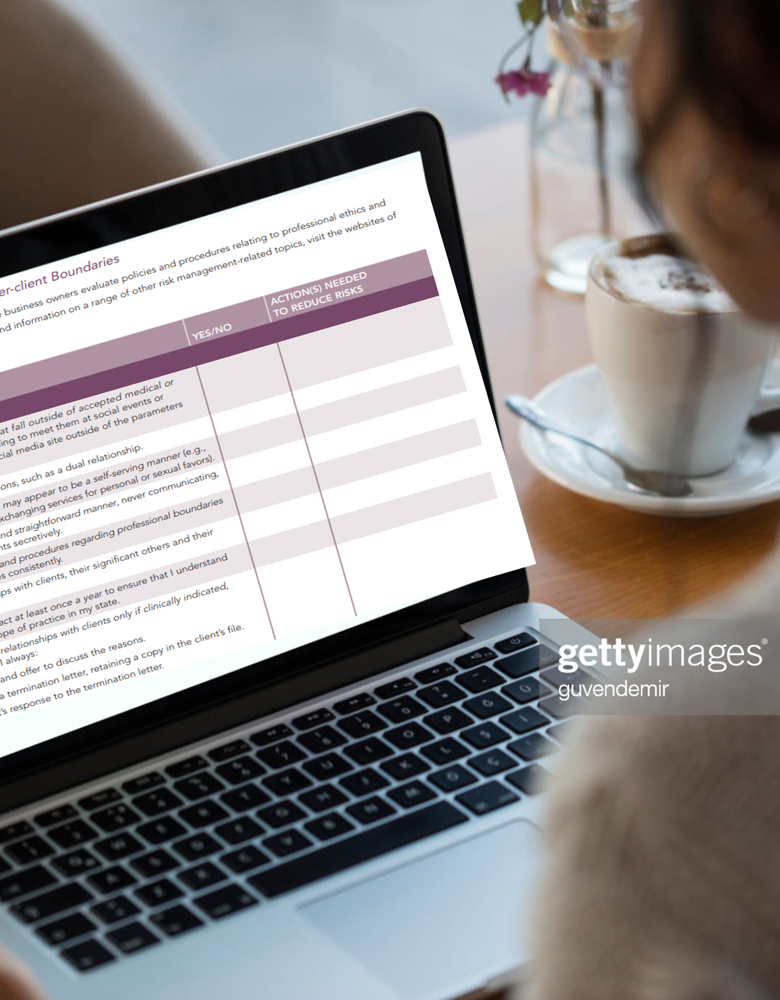
Why Attend This Program?
Sharpen your nursing, social work, or case management skills.
Observe others as they participate in interactive on-site activities.
Takes you into the classroom setting without the cost, inconvenience, and time involved in travel.

Slide 8

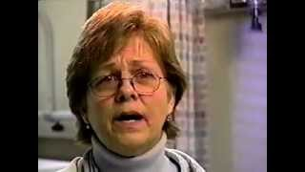
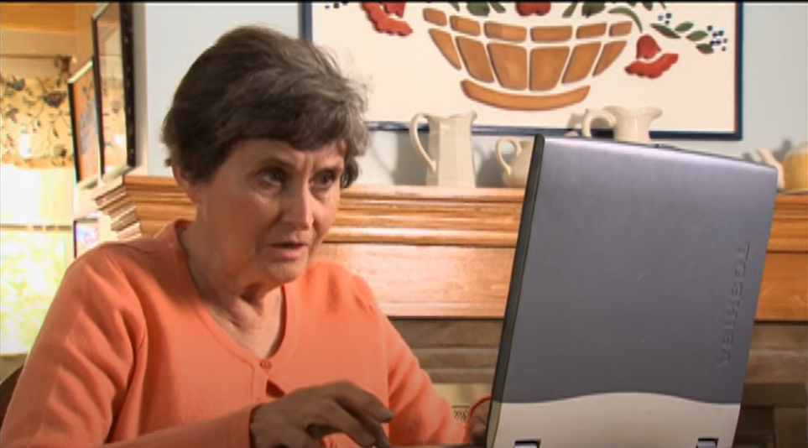
13 Embedded Videos Enhance Understanding of Each Topic, For Example
Brené Brown on Empathy
https://youtu.be/1Evwgu369Jw
Health Literacy https://youtu.be/ubPkdpGHWAQ
Community Resources
https://youtu.be/wFZtfiN196s

Slide 9

Case Studies Apply Case Management Principles

Slide 10

CCM Exam Practice Questions
Practice exam questions and rationale offered for each segment of the program.

Slide 11
Additional Benefits
7-week, self-paced course
14 continuing education credits
  Registered Nurses: 14 CE contact hours provided by Relias
  Case Managers: 14.0 CCM clock hours provided by Mullahy & Associates
  Social Workers: 14 CE clock hours provided by Mullahy & Associates

Slide 12
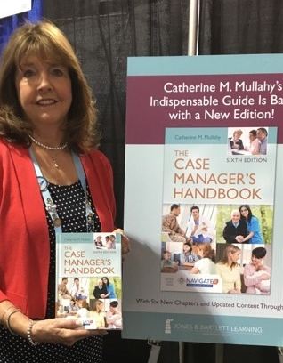
Additional Benefits
Network with instructors and other CMs through additional weekly opportunities with questions and “food for thought” topics during the 7 weeks
Download resources: slides from each module and the workbook
Special Offer: 20% discount and personal inscription
Author: Catherine M. Mullahy, RN, BSN, CRRN, CCM, FCM

Slide 13
Testimonials
“This Best-In-Class Case Management Focused CE Series has definitely given me the tools to better understand case management. I plan to sit for my CCM certification in the near future with the confidence. Thank you so much for designing the series!”
Tiffany J., BSN, RN
“I found the course invaluable and a great way to brush up on case management skills. The content, relevancy and the instructors were awesome. The course was comprehensive and easy to follow. Definitely would recommend for both new CM’s as well as experienced case managers.”
Joanita M., MSW, LCSW, OSW-C
“I was pleased with the format and the educational reviews at the end of every module. The program opened my eyes to an in-depth perspective of case management, helped me realize the importance of the job and how I can better facilitate resources to patients.”
Saraih A., BSN, RN, Heart Failure Care Manager

Slide 14
References
Johns Hopkins – AI. (2012, Aug 23). AMA health literacy video – short version. [Video]. YouTube. (3:59 min). https://m.youtube.com/watch?v=ubPkdpGHWAQ
KBYUEleven. (2009, Oct 20). Economic cents: how do I find community resources? [Video]. YouTube. (3:37 min). Economic Cents: How Do I Find Community Resources? - YouTube
RSA. (2013, Dec. 10). Brené Brown on empathy. [Video]. YouTube. (2:53). https://www.youtube.com/watch?v=1Evwgu369Jw

Slide 15


Thank You
Each Case Manager Makes a Difference …
One Patient at a Time.
For more learning opportunities, visit Nurse.com.

